Slide 1
Module 1 Overview of Relational Database Support
Lesson 4: Relational Database Schema Patterns
Notes:
Welcome to Unit 1 on SQL Subtotal operators
Part 2 is review from unit 3 of course 2 for students who did not take course 2 or want a quick refresher.
Objectives:
Understand the motivation for relational database representation of multidimensional data
Understand basic ideas of fact and dimension tables
Recognize data modeling patterns for data warehouse schemas

Slide 2
Lesson Objectives
Review schema patterns
Understand data warehouse used in ungraded exercises
Understand data warehouse used in graded assignments

Slide 3
Star Schema Example
Notes:
Star schema:
- One fact table in the center
- Multiple dimension tables
- Represents one data cube
- DW may contain many star schemas

Slide 4
Constellation Schema Example
Notes:
Constellation schema:
- Multiple fact tables
- Dimension tables share fact tables
- Relationship diagram looks like a constellation

Slide 5
Extended Constellation Schema
Item sales, Subscription sales, Inventory cost
Store
Lead
Supplier
Item
Customer
Package
Format
TimeDim
Notes:
Measures
Product sales: point of sale
Subscription sales
Supplier performance: order (quantity and cost), returns (quantity and value), rejects (quantity and value) lead time, stock outage
Dimensions
Format: media
Package: types of subscription packages
Lead: referring page
Associated with subscription: lead, package, format
Associated with physical presence: store
Common dimensions for physical sales and subscription: customer, date, item
Associated with supplier performance: date, supplier, item

Slide 6
Matrix for a Constellation Schema
Dimensions | Facts
 | Product Sales | Subscription Sales | Inventory
Store | X
Item | X | X | X
Customer | X | X
Lead |  | X
Package |  | X
Format |  | X
Supplier |  |  | X
TimeDim | X | X | X
Notes:
For a complex constellation diagram, a matrix provides a convenient mapping of dimensions and facts. This matrix shows a mapping of the simplified schema diagram shown previously. Item and TimeDim are shared in all three schemas. Most dimensions appear in two schemas. Shared dimensions are conformed or standardized across schemas. Supplier and Store are used in only one schema each.
Even a matrix becomes unwieldy for a moderate data warehouse. A moderate size data warehouse can have 10 facts and 30+ dimensions, making the matrix too large to show on a standard page. The matrix can be partitioned to show on several pages or zoomed from a high level with dimensions and facts grouped.

Slide 7
Snowflake Schema Example
Notes:
Snowflake schema:
- Multiple levels of dimension tables
- Use when dimension tables are small: little performance gain by denormalizing
- Relationship diagram looks like a snowflake

Slide 8
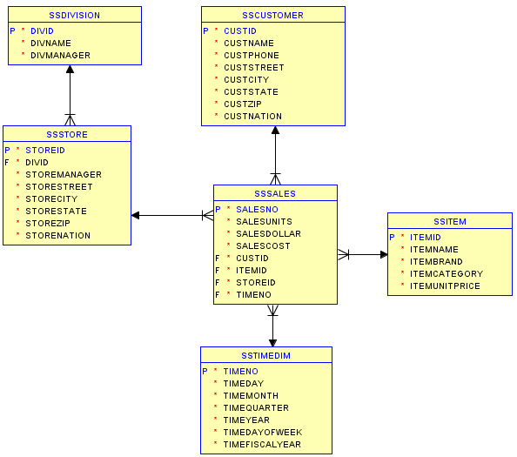
Oracle Diagram for the Store Sales DW
Notes:
SS prepended to the table names to avoid table name conflicts in my schema

Slide 9
Inventory Lifecycles
Notes:
Because inventory management is a common and important yet difficult activity in many organizations, ERP vendors have developed Enterprise Resource Management (ERP) software to provide software support. Typically, ERP software provides modules related to Manufacturing, Distribution/Logistics, Financials, and HR/Payroll. Inventory is at the heart of the Manufacturing and Distribution/Logistics modules. The work order, sales, and purchase life cycles affect the perpetual inventory balance as shown in Figure 1. In addition, inventory transactions including adjustments, transfers, issues, and reclassifications affect the perpetual inventory balance.

Slide 10
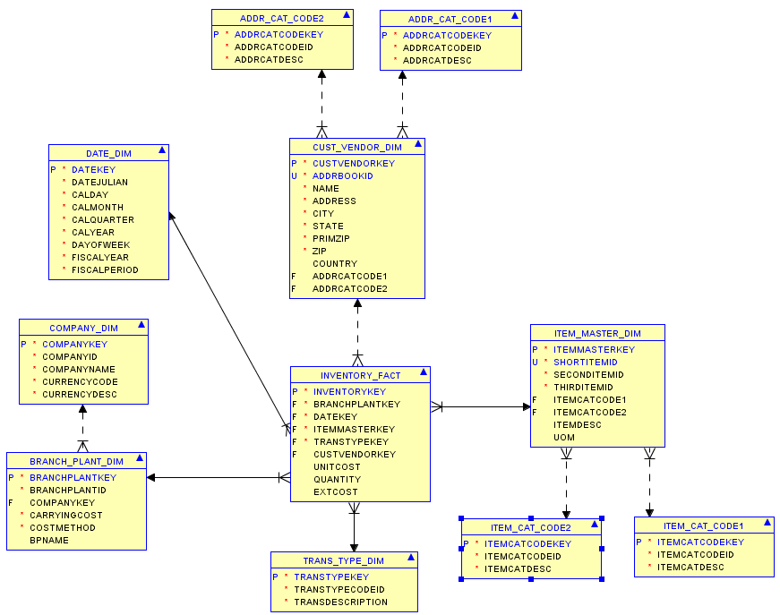
Oracle Diagram for the Inventory DW
Notes:
Snowflaking
Company_Dim to Branch_Plant_Dim
Item_Cat_Code 1 to Item_Master_Dim
Item_Cat_Code 2 to Item_Master_Dim
Addr_Cat_Code1 to Cust_Vendor_Dim
Addr_Cat_Code2 to Cust_Vendor_Dim

Slide 11
Summary
Understand schema patterns for query formulation
Store sales data warehouse for practice problems
Inventory data warehouse for graded problems
Course documents for both data warehouses
Notes:
Schema patterns
Fact and dimension tables
Schema patterns: star (radial pattern), constellation (sharing of dimension tables among stars), and snowflake (1-M relationships among dimension tables)
Simple schema patterns
Patterns are simple, typically constellation without snowflaking
Many dimension tables make schema diagrams difficult to read (busy).
Data cube representation
Subtotals showing totals for rows, columns, and other dimensions
SQL subtotal operators provide subtotals so that query results have same information as data cube operations

